Slide 1
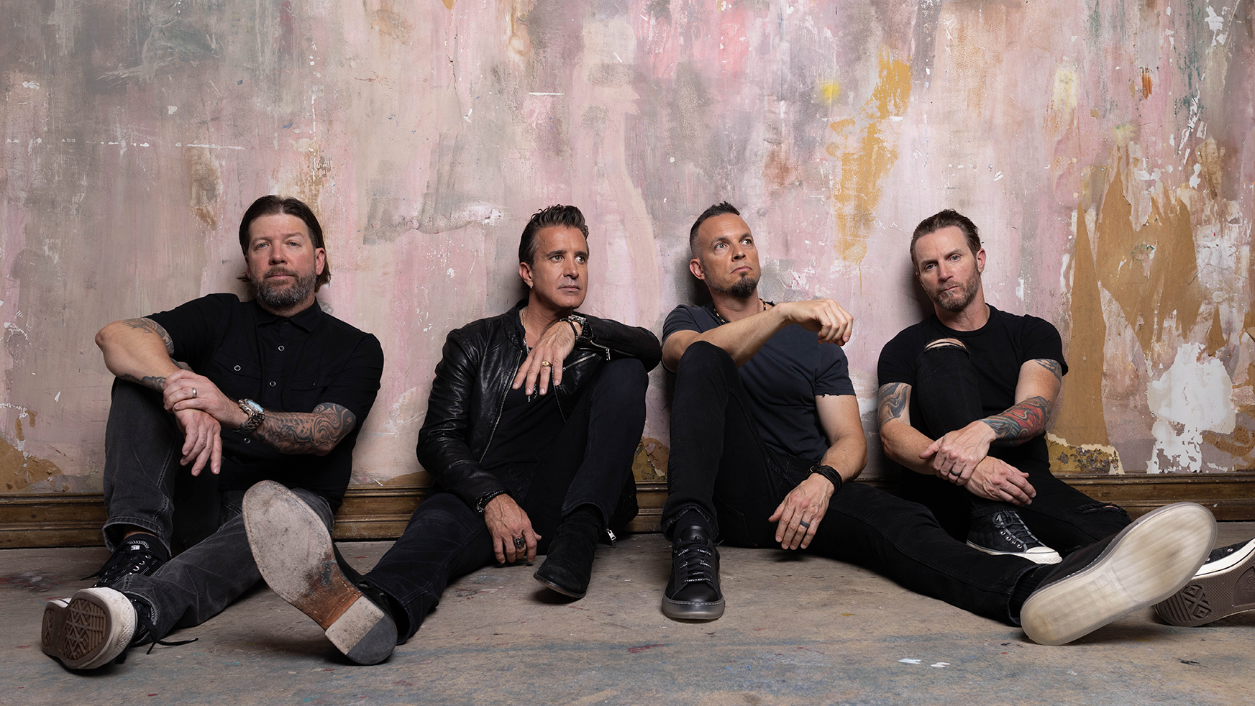
Creed: Christian Rock or Just Rocking Christians?
Anthony Fernandez

Slide 2
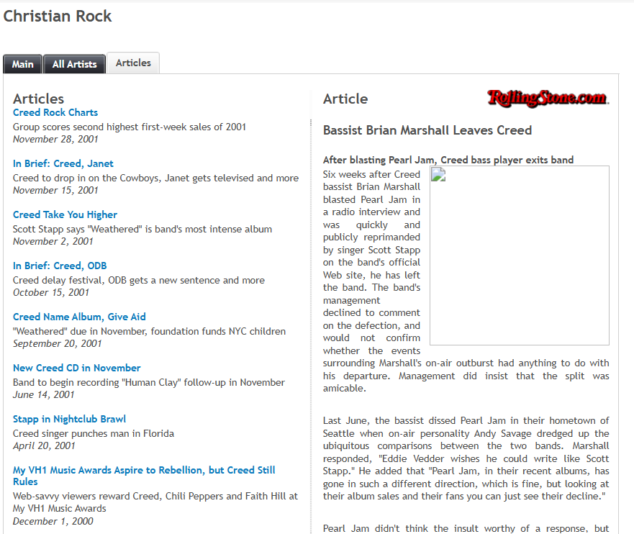
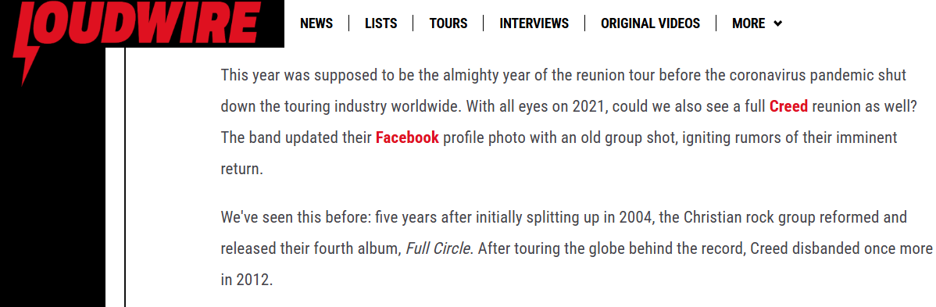
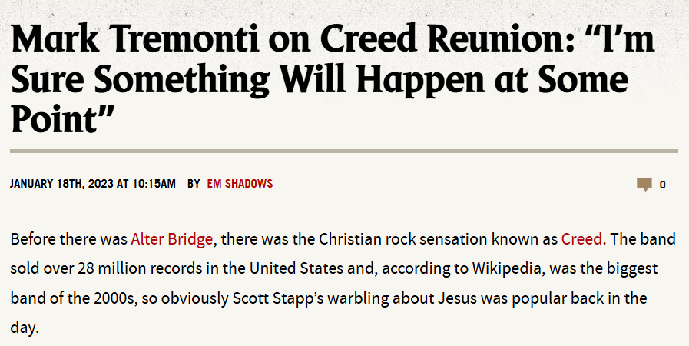
loudwire.com
metalsucks.net
uk.real.com

Slide 3
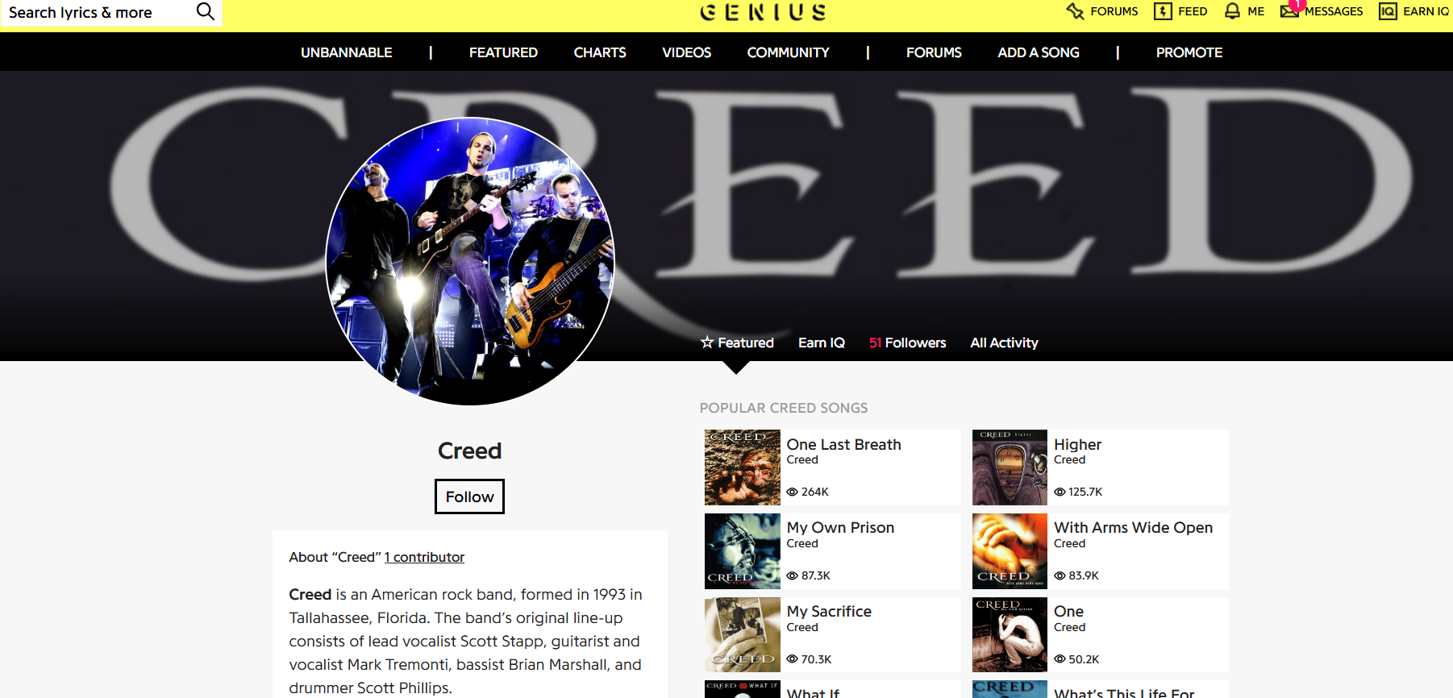

Slide 4


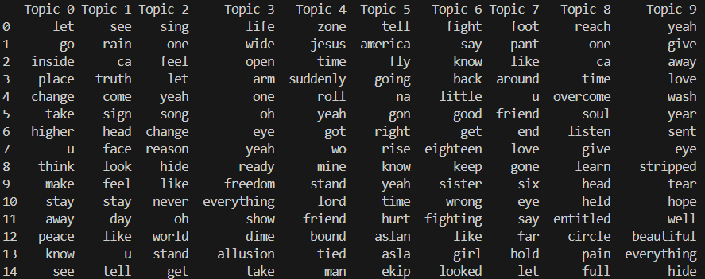



Latent Dirichlet Allocation

Slide 5

Jesus God Christ Faith Pray Prayer Bible Church Heaven Grace Gospel Salvation Holy Spirit Lord Redeem Forgive Sin Believe Worship Glory Cross Crucify Messiah Hallelujah Praise Blessing Miracle Sacred Eternal Trinity Disciple Apostle Covenant Resurrection Righteous Commandments Truth Mercy Light Love Peace Prophet Kingdom Charity Repent Shepherd Sacrifice Revival Deliverance
250 Religious Christian Words

Slide 6
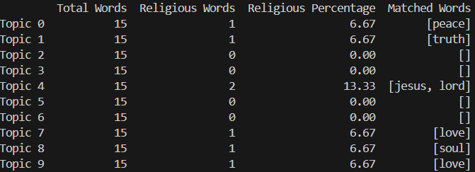
Results

Slide 7
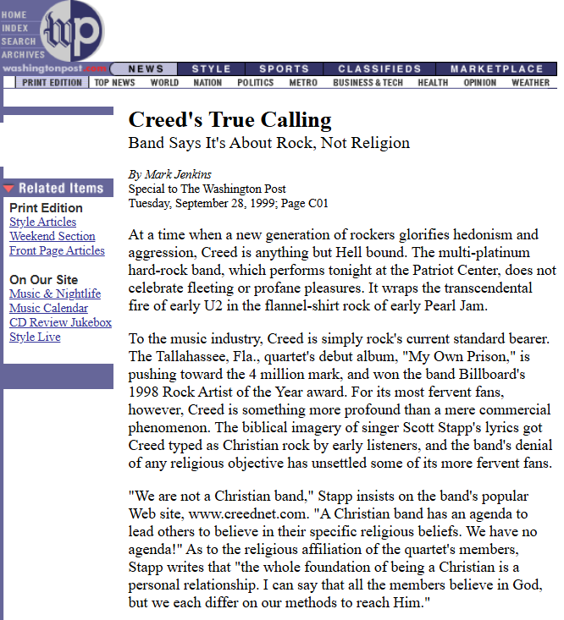

Slide 8

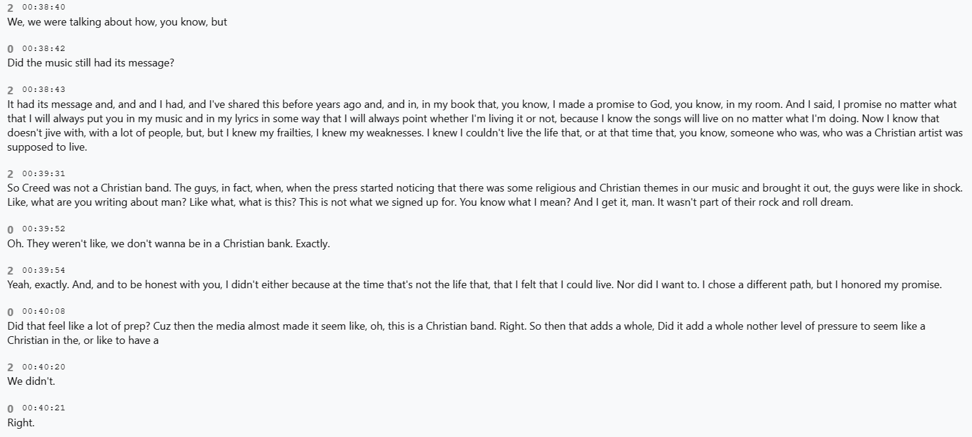

Slide 9

Creed: A Higher Purpose or Just Higher Charts?

Slide 10
Sources
https://web.archive.org/web/20190427213543/http://www.washingtonpost.com/wp-srv/WPcap/1999-09/28/010r-092899-idx.html
https://web.archive.org/web/20100302212304/http://uk.real.com/music/genre/Christian_Rock/articles/375445/-related-articles-page-5/
https://www.metalsucks.net/2023/01/18/mark-tremonti-on-creed-reunion-im-sure-something-will-happen-at-some-point/
https://chatgpt.com/
https://loudwire.com/creed-reunion-rumor-2020/
https://genius.com/artists/Creed
https://app.podscribe.ai/episode/83925922?tabValue=1

